Slide 1
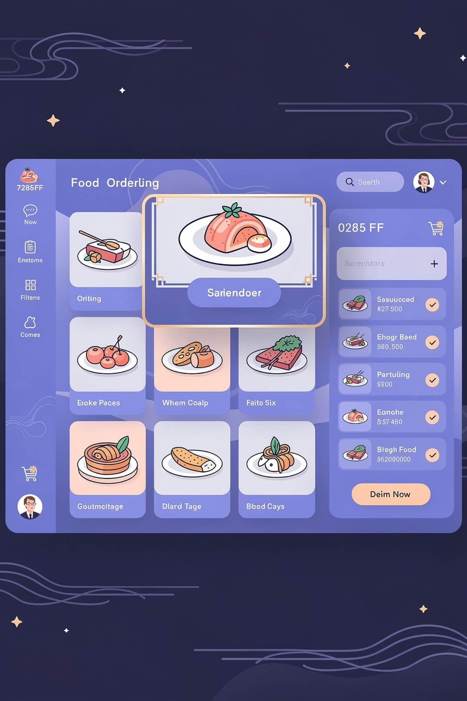
Foodie Application
Seamless, Secure & Smart Food Ordering Experience
By-Mohammad Ghazi Abbas

Slide 2
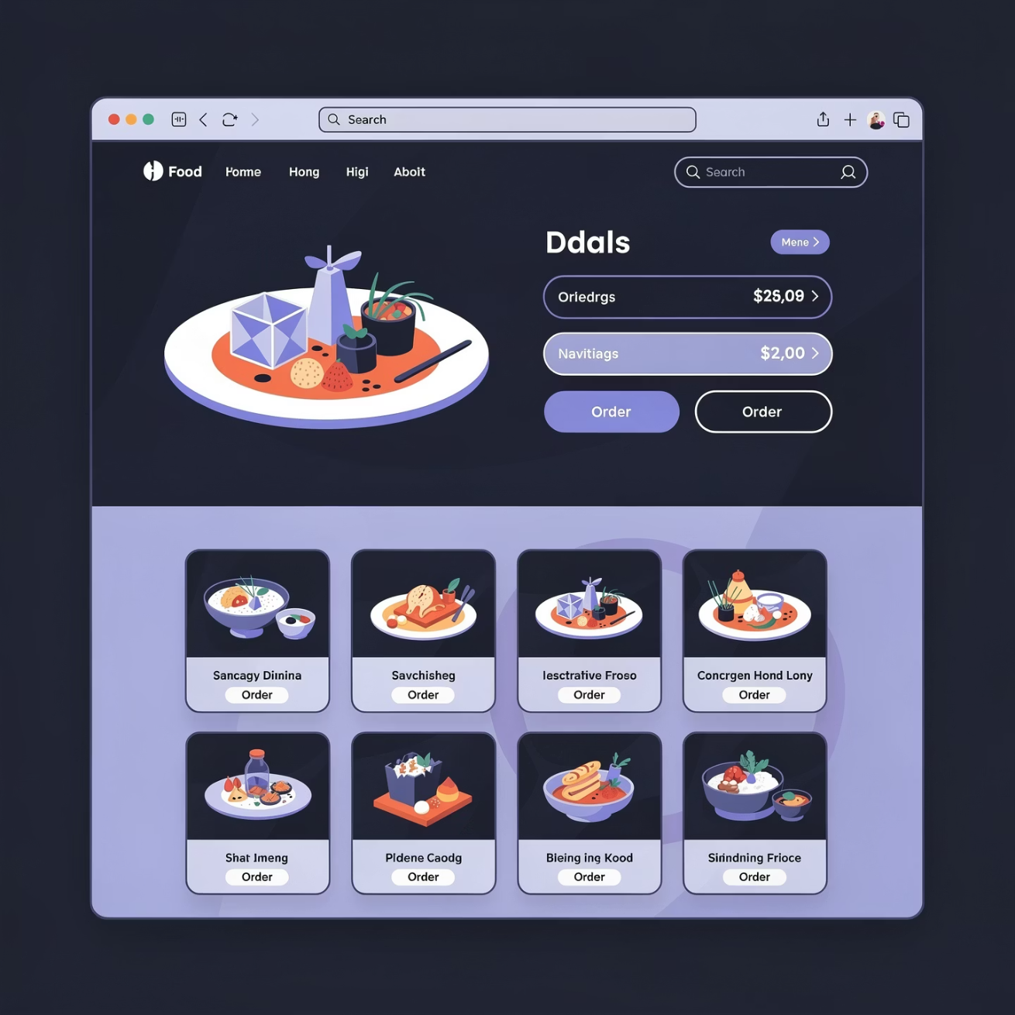
PLATFORM OVERVIEW
Introduction to Foodie Application
Complete End-to-End Food Ordering Solution
Foodie is a comprehensive web-based food ordering platform designed to connect everyone in the food delivery ecosystem.
Multi-role platform supporting five distinct user types
Seamless experience from browsing to delivery
Built for scalability and security
2

Slide 3
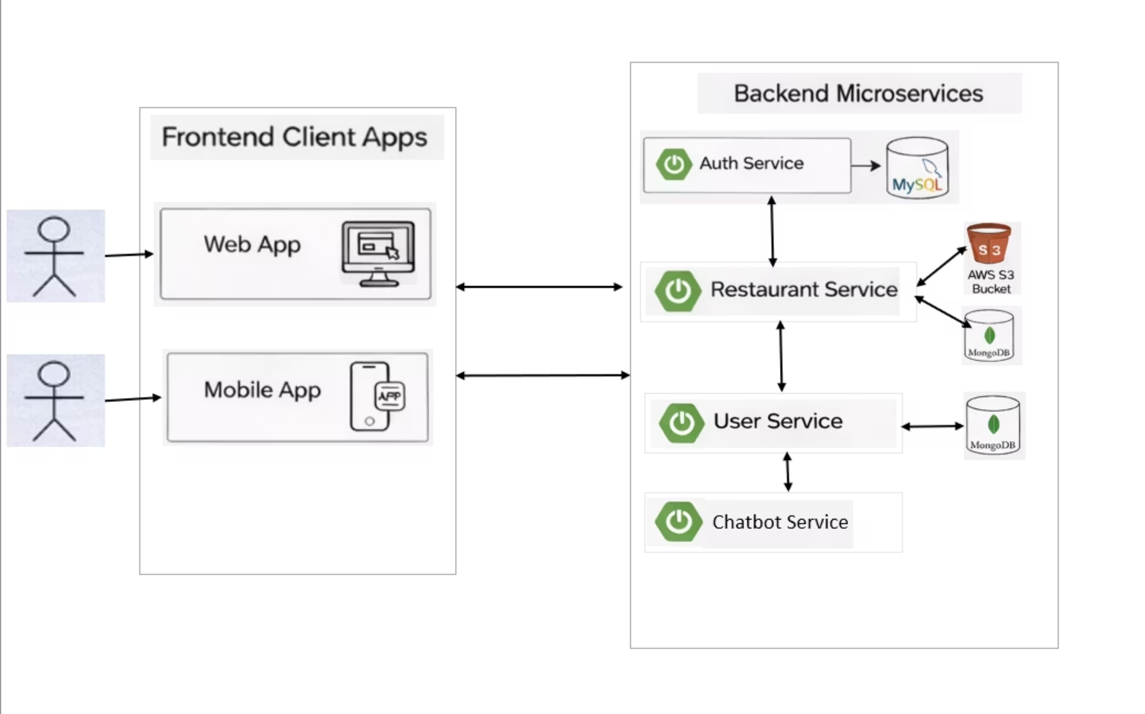
FOODIE APPLICATION
System Architecture
Direct communication between frontend apps and backend microservices (no API gateway)
Five core microservices: Auth (MySQL), User (MySQL), Restaurant (MongoDB + AWS S3), Order (MySQL + MongoDB), AI Service (OpenAI)
Single user can access multiple roles: Customer, Restaurant Owner, Admin, or Delivery Partner
3

Slide 4









FOODIE APPLICATION
USER JOURNEY
Complete User Journey Flow
Guest Browsing
Explore restaurants and menus without commitment
Sign Up / Login
Quick registration to unlock full platform features
Browse & Discover
Search food with smart filters and AI assistance
AI Chatbot Help
Get recommendations and food insights instantly
Add Favourites
Save preferred items for future orders
Place Order
Secure checkout with multiple payment options
Restaurant Processing
Real-time order tracking and status updates
Delivery & Review
Rate experience and share feedback with community
4

Slide 5





FOODIE APPLICATION
GUEST ACCESS
Explore Before You Commit
Browse Freely
View Details
Login to Order
Explore restaurants and view menus without registration
Check food items, prices, and basic information
Sign up required for orders, favourites, and reviews
5

Slide 6
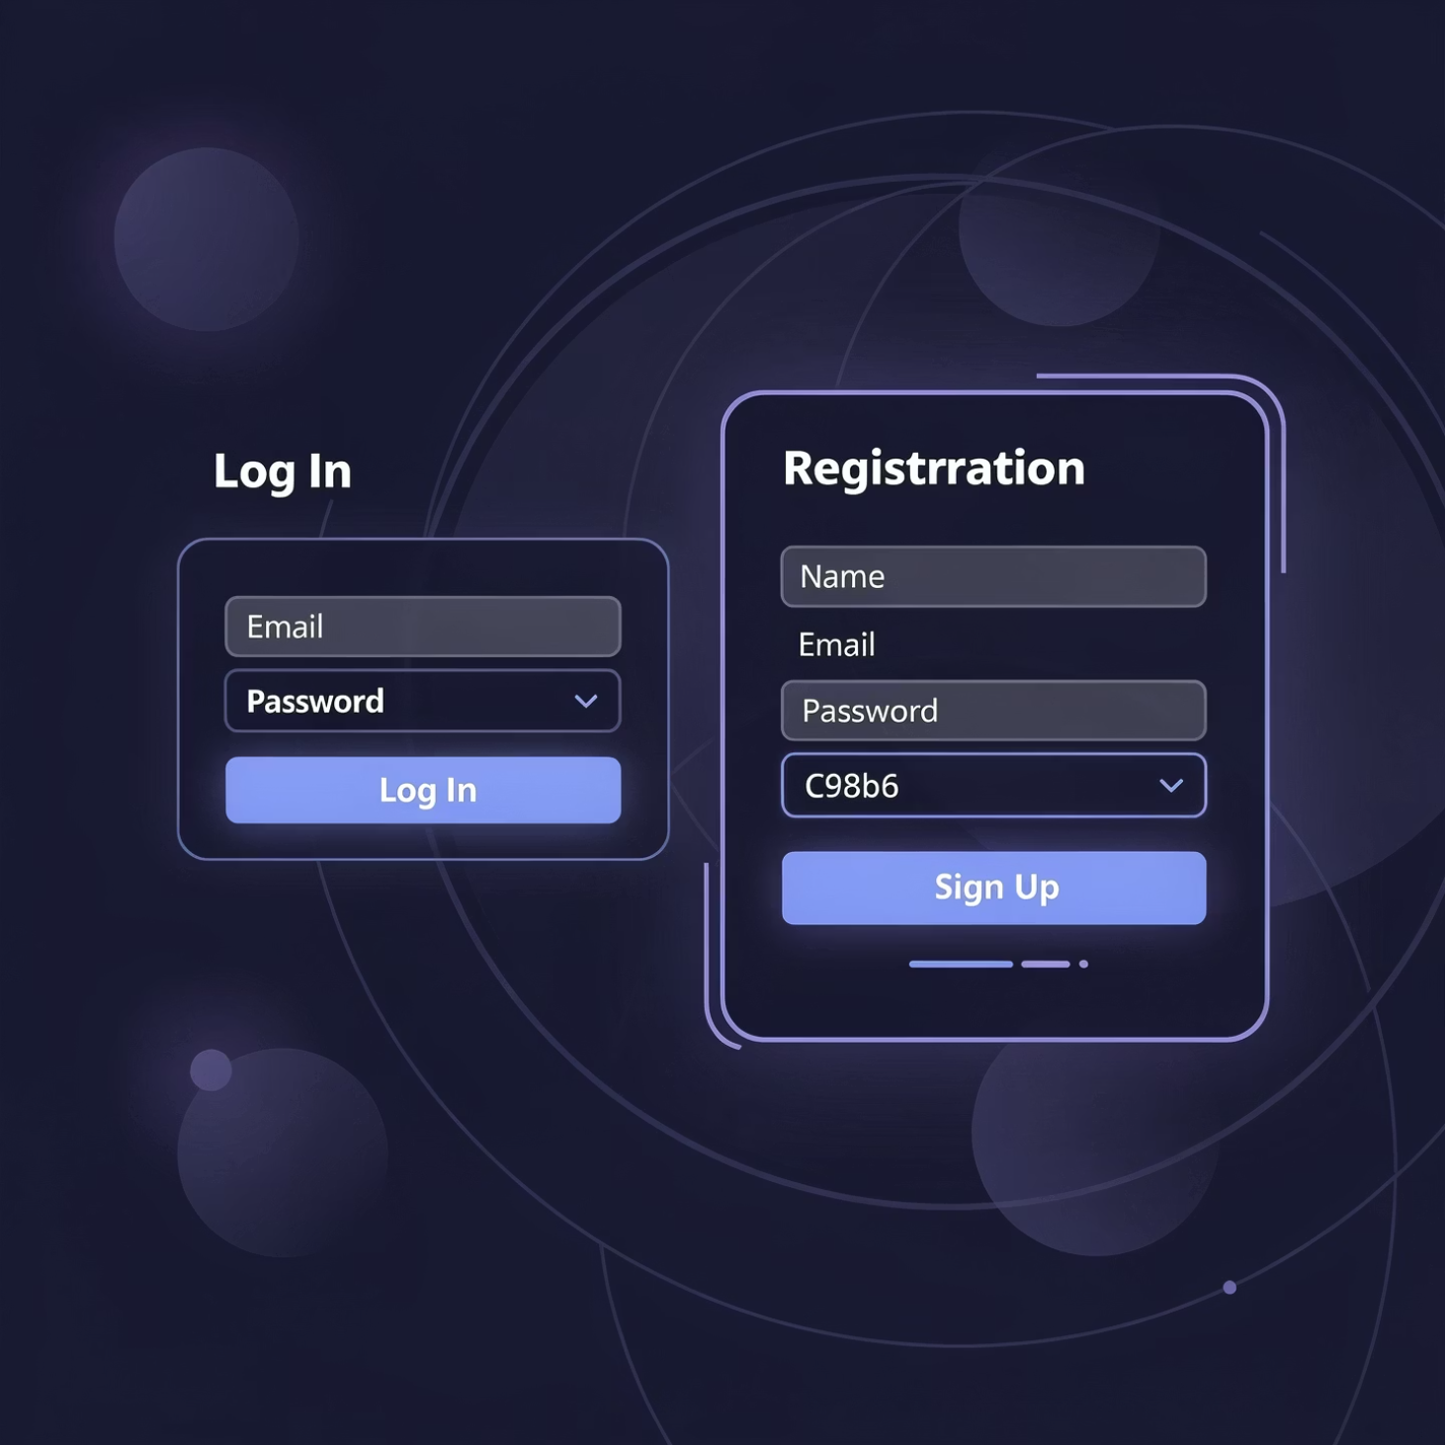
FOODIE APPLICATION
Quick & Secure Registration
01
Simple Sign Up
Create your account in seconds with basic details
02
Secure Authentication
Industry-standard security protecting your data
03
Smooth Onboarding
Start ordering immediately after registration
6

Slide 7

FOODIE APPLICATION
Restaurant Partner Registration & Approval Process
Restaurant owner registers on the platform as a Restaurant Partner
Owner submits restaurant details (name, address, category, documents)
Registration request is sent to Admin for verification
Admin approval is mandatory before accessing restaurant features
Ensures authenticity, quality control, and platform trust
Owner Submits
Admin Review
Approval
Dashboard Access
7

Slide 8
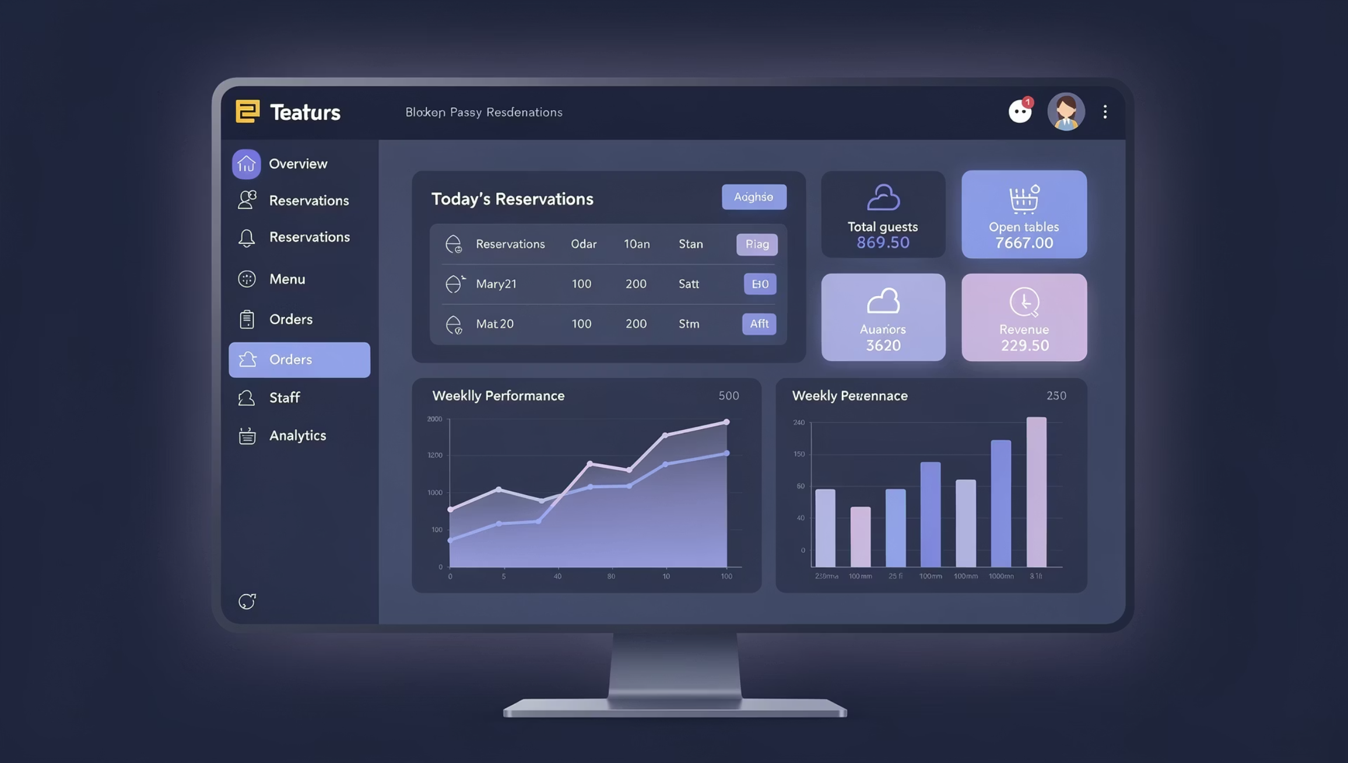
FOODIE APPLICATION
Restaurant Owner Dashboard
Centralized web dashboard for restaurant management
Easy navigation for:
Menu Management
Live Orders
Order History
Earnings & Analytics
Real-time updates for orders and performance
Designed for fast and efficient restaurant operations
8

Slide 9
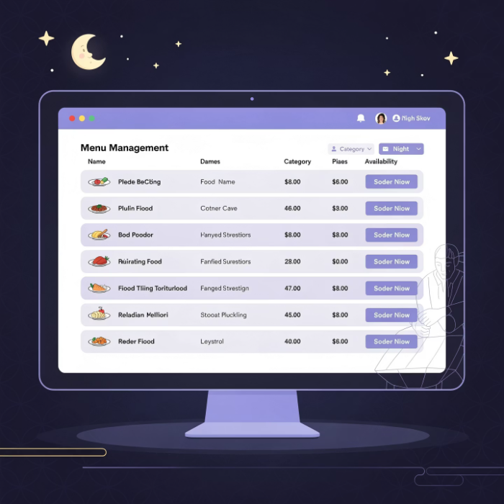
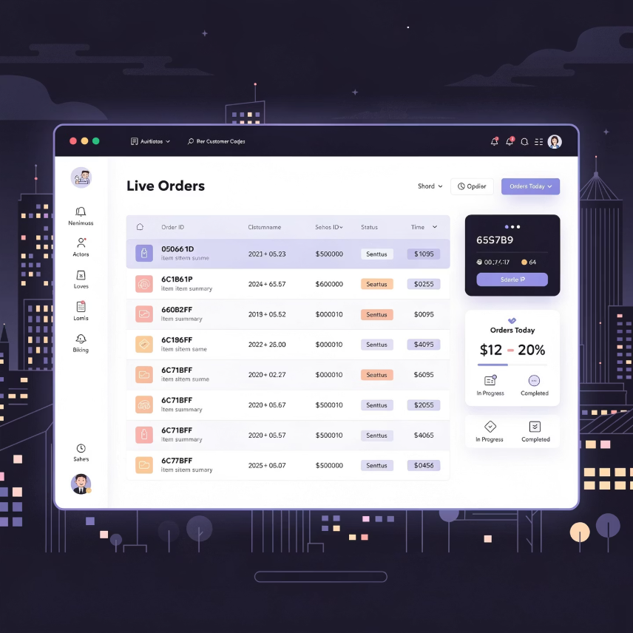
FOODIE APPLICATION
Menu Management & Order Processing
Add menu items easily
Set item availability (Available / Out of Stock)
View Live Orders in real time
Accept or reject customer orders instantly
Smooth order flow from customer to kitchen
9

Slide 10
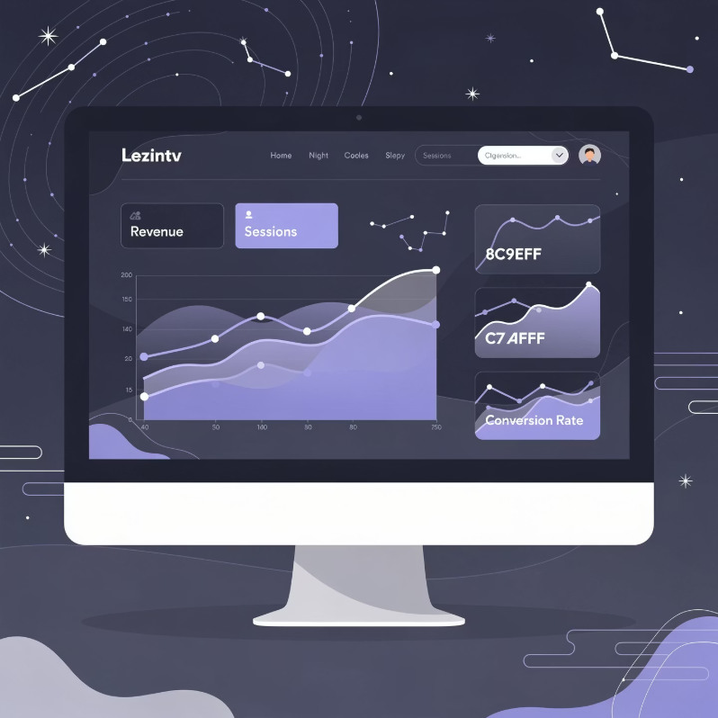
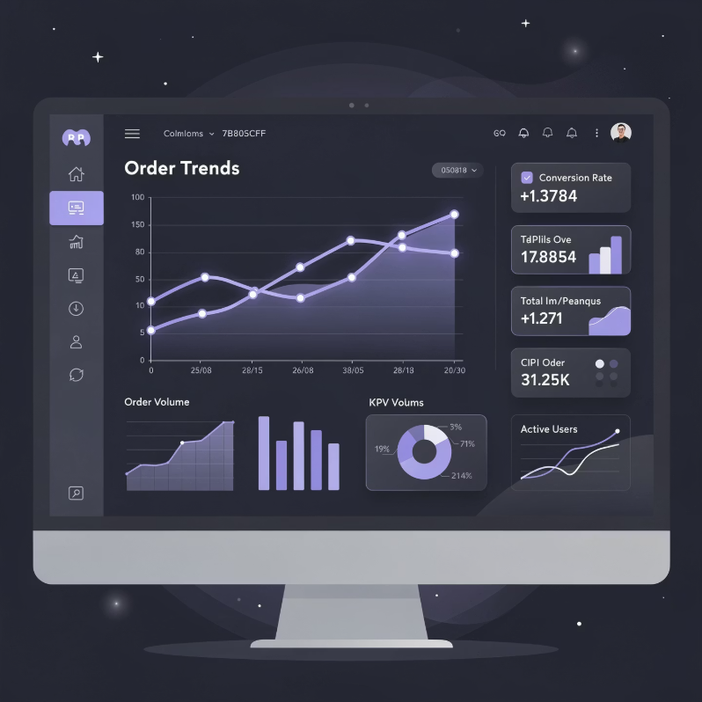
FOODIE APPLICATION
Revenue Insights & Performance Analytics
Track total revenue generated
View weekly and monthly earnings
Separate view of:
Completed revenue
Pending revenue
Analyze order trends:
Average orders per day
Peak business days
Visual graphs for better decision-making
10

Slide 11






FOODIE APPLICATION
Restaurant Owner Flow
Registration & Approval
Dashboard Access
Menu Management
Restaurant owner registers and waits for admin approval
Access to restaurant management dashboard
Add/update menu items and set availability
Order Processing
Revenue Tracking
Receive and manage customer orders in real-time
Monitor earnings and business analytics
11

Slide 12

FOODIE APPLICATION
TECHNOLOGY STACK
Technology Stack
Frontend
Backend
React.js
HTML/CSS
JavaScript
Responsive Design
Spring Boot
MySQL/PostgreSQL
MongoDB
AWS S3
REST APIs
Microservices
12

Slide 13






FOODIE APPLICATION
USER ROLES
Four Distinct Access Levels
Single platform with role-based access control ensuring everyone gets exactly what they need
Customer
Restaurant Owner
Browse, order, review, and receive AI-powered assistance
Manage menus, prices, orders, and business operations
Delivery Partner
Admin
Handle deliveries and fulfil customer orders efficiently
Oversee platform operations, users, and all stakeholders
13

Slide 14
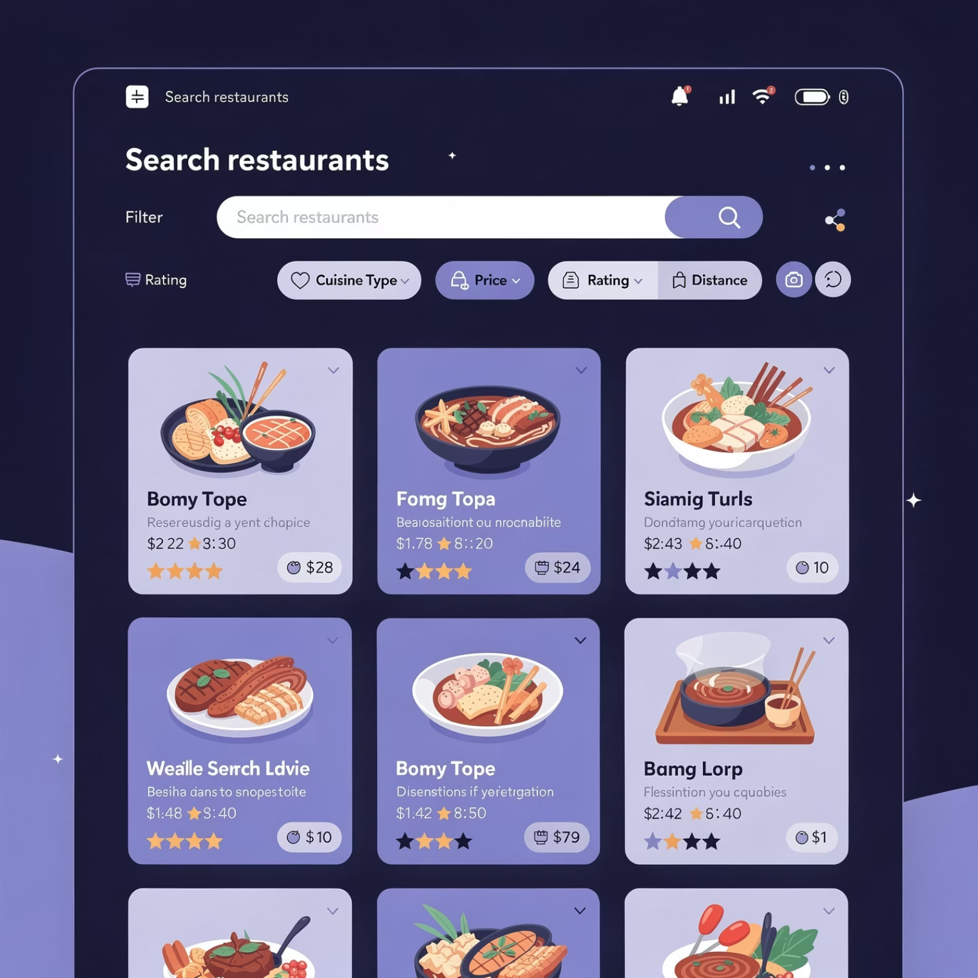
FOODIE APPLICATION
Smart Food Discovery
Browse & Search Effortlessly
Intuitive restaurant browsing with rich visuals
Powerful search filters for quick discovery
Smooth, responsive website experience
Detailed menu views with pricing and descriptions
Finding your next meal has never been easier with our streamlined discovery interface
14

Slide 15
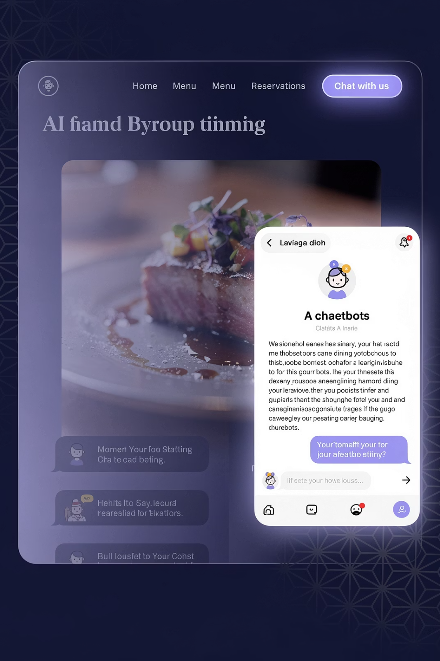




FOODIE APPLICATION
AI-POWERED
Intelligent Food Assistance
24/7 Chatbot Support
Get instant answers to questions about ingredients, preparation, and dietary information
Smart Recommendations
Receive personalised food suggestions based on preferences and past orders
Enhanced Decision-Making
Make informed choices with AI-generated insights and detailed food information
15

Slide 16
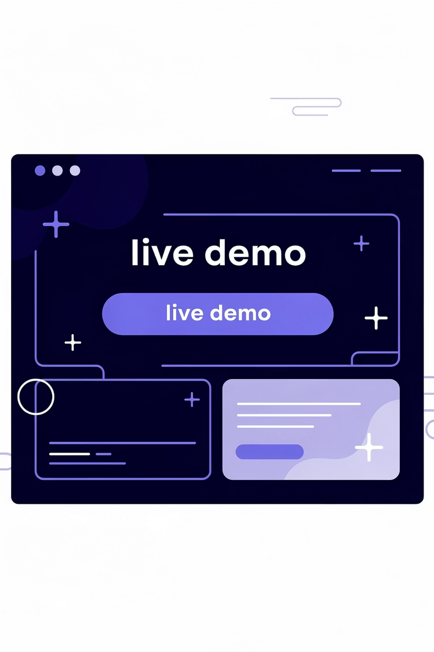


FOODIE APPLICATION
EXPERIENCE IT LIVE
Ready for a Live Demo
Explore the Foodie Application in action and see how seamlessly it handles the complete food ordering journey
Live Demo
Experience real-time working of all features: browsing, AI assistance, ordering, and role-based dashboards
16

Slide 17
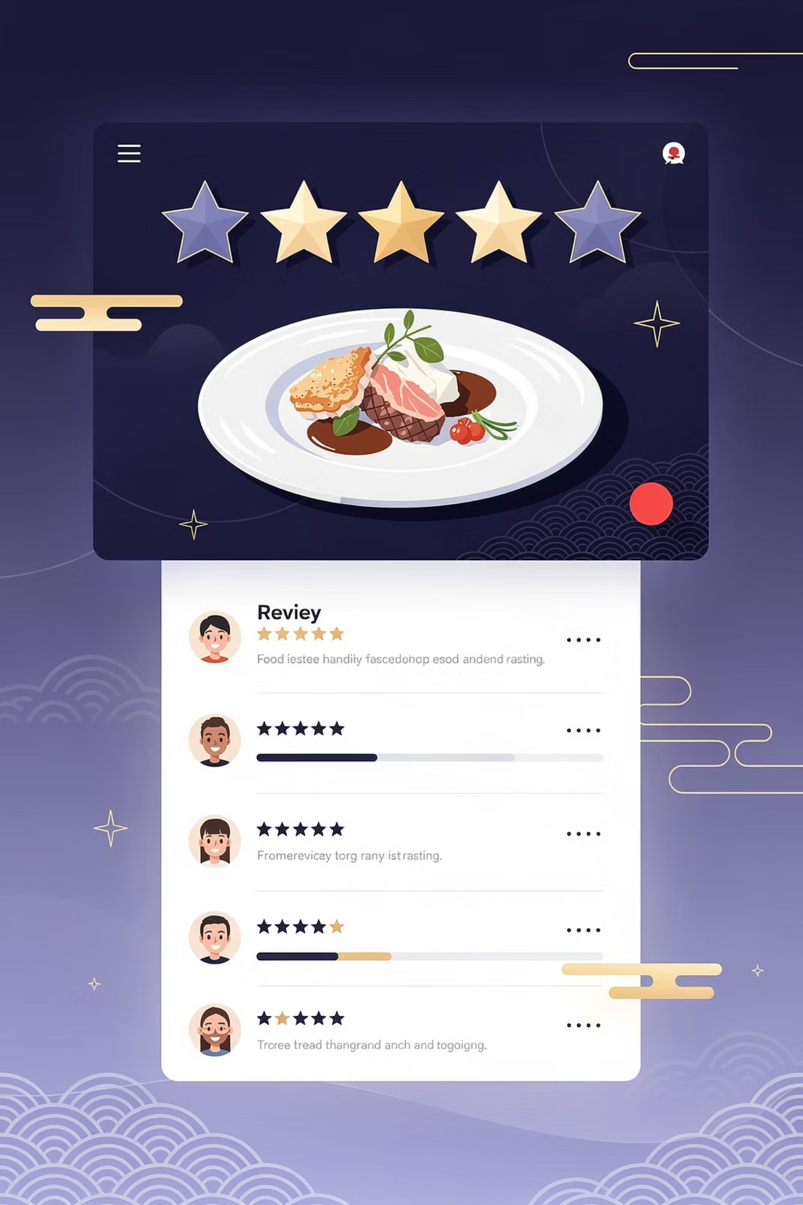
FOODIE APPLICATION
Favourites, Reviews & Ratings
1
Save Favourites
Bookmark your preferred dishes for quick access
2
Rate Your Experience
Give star ratings based on food quality and service
3
Share Reviews
Help others make informed decisions with detailed feedback
4
Build Community Trust
Contribute to a transparent, user-driven platform
17

Slide 18





FOODIE APPLICATION
WHAT'S NEXT
Future Innovations & Enhancements
Personalised Offers
Advanced AI Recommendations
Targeted promotions and loyalty rewards for frequent customers
Machine learning-powered personalised suggestions based on behaviour patterns
Enhanced Analytics
Premium Subscriptions
Deep insights for admins and restaurant owners to drive growth
Exclusive benefits including free delivery and priority support
Focused on continuous improvement, scalability, and delivering exceptional value to all stakeholders
18

Slide 19
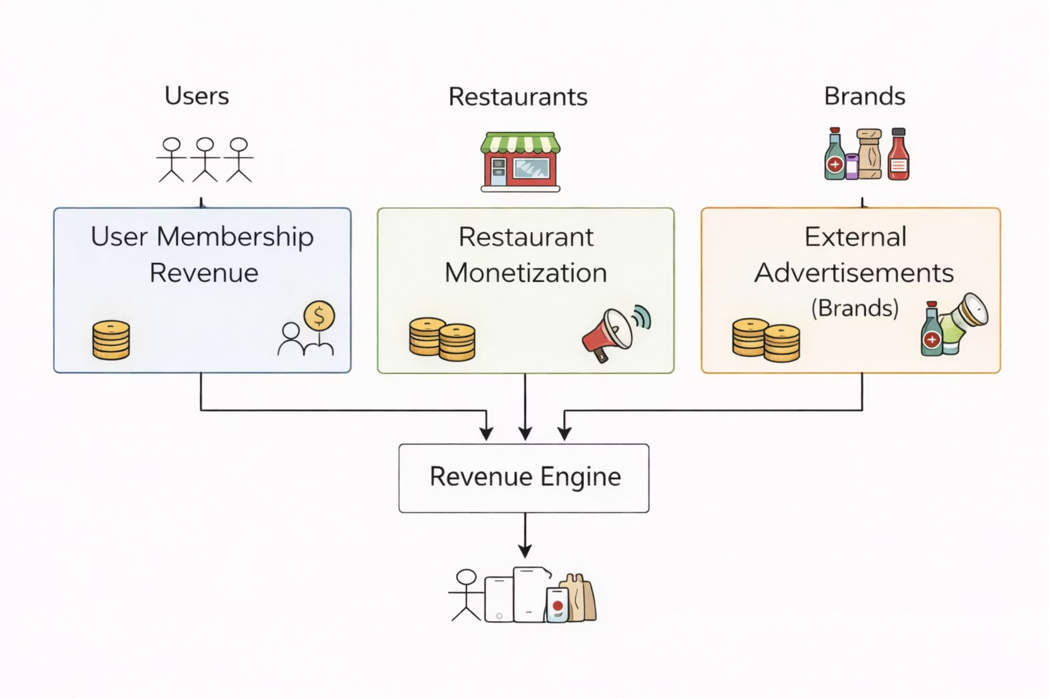
FOODIE APPLICATION
Revenue Model
User Membership Revenue: Premium subscriptions for exclusive benefits and features
Restaurant Monetization: Commission on orders and featured listing fees
External Advertisements: Brand partnerships and sponsored content from food/beverage companies
Multi-stream revenue engine powering sustainable platform growth
19

Slide 20
FOODIE APPLICATION
Thank You!
Do You Have Any Questions for Us?
We would be delighted to explain or demonstrate any feature in detail
Looking forward to your valuable feedback and insights
Ankit Raj & Mohammad Ghazi Abbas • Foodie Application Team
20

